Slide 1

Zomato Restaurant analysis
Mentor –
Co-Mentor – Mr. Sivakumar Rajasekaran
Team - 1
Mr. Chaitanya Narhe
Ms. Sheetal Choudhary
Mr. Sohail Bachne
Ms. Saluwadhi Krupa Sai
Mr. Mohammed Taj
6/12/2023
🍔🍕🍟🌭🍾🍷🍸🍹🍺🍻🥂

Slide 2
Introduction
The Zomato Restaurant Analysis Project aims to drive deep into this treasure trove of data and uncover insights that will shed light on the Restaurants. By analyzing various factors such as cuisine, location, user ratings, restaurant openings, and more, we seek to understand the dynamics that shape the success and popularity of restaurants.
Through this project, we hope to provide restaurant owners, investors, and food enthusiasts with valuable information and actionable insights to make informed decisions. By exploring trends and patterns within the Zomato data, we can identify key drivers of success, discover hidden gems, and gain a comprehensive understanding of consumer preferences and behaviors.
The project will employ advanced data analysis techniques and visualization tools to transform raw data into meaningful insights. By examining factors such as customer sentiment, price-performance ratios, and geographical distribution, we aim to paint a comprehensive picture of the restaurant industry, uncovering both opportunities and challenges.
🍔🍕🍟🌭🍾🍷🍸🍹🍺🍻🥂

Slide 3
We perform this project in 4 modules :-
Excel
Tableau
Power Bi
SQL
🍔🍕🍟🌭🍾🍷🍸🍹🍺🍻🥂

Slide 4
Excel
We receive our dataset in excel sheet. It contain all information related to Zomato restaurants. By using our main data we create three more table. Calendar table, country table, currency table.
Calendar table has sorted opening dates of all the restaurants from 2010 to 2018. then we extract date, Year, Month, Quarter, Month name, Year-month, weekday, weekday number, weekday name, financial month, financial quarte.
Country table has two column country id, country name. country name is not provided in the dataset. Then by using city name we are able to find the country name.
Currency table has three column currency id, country name, usd rate. We find usd rates for particular country using google.
🍔🍕🍟🌭🍾🍷🍸🍹🍺🍻🥂

Slide 5
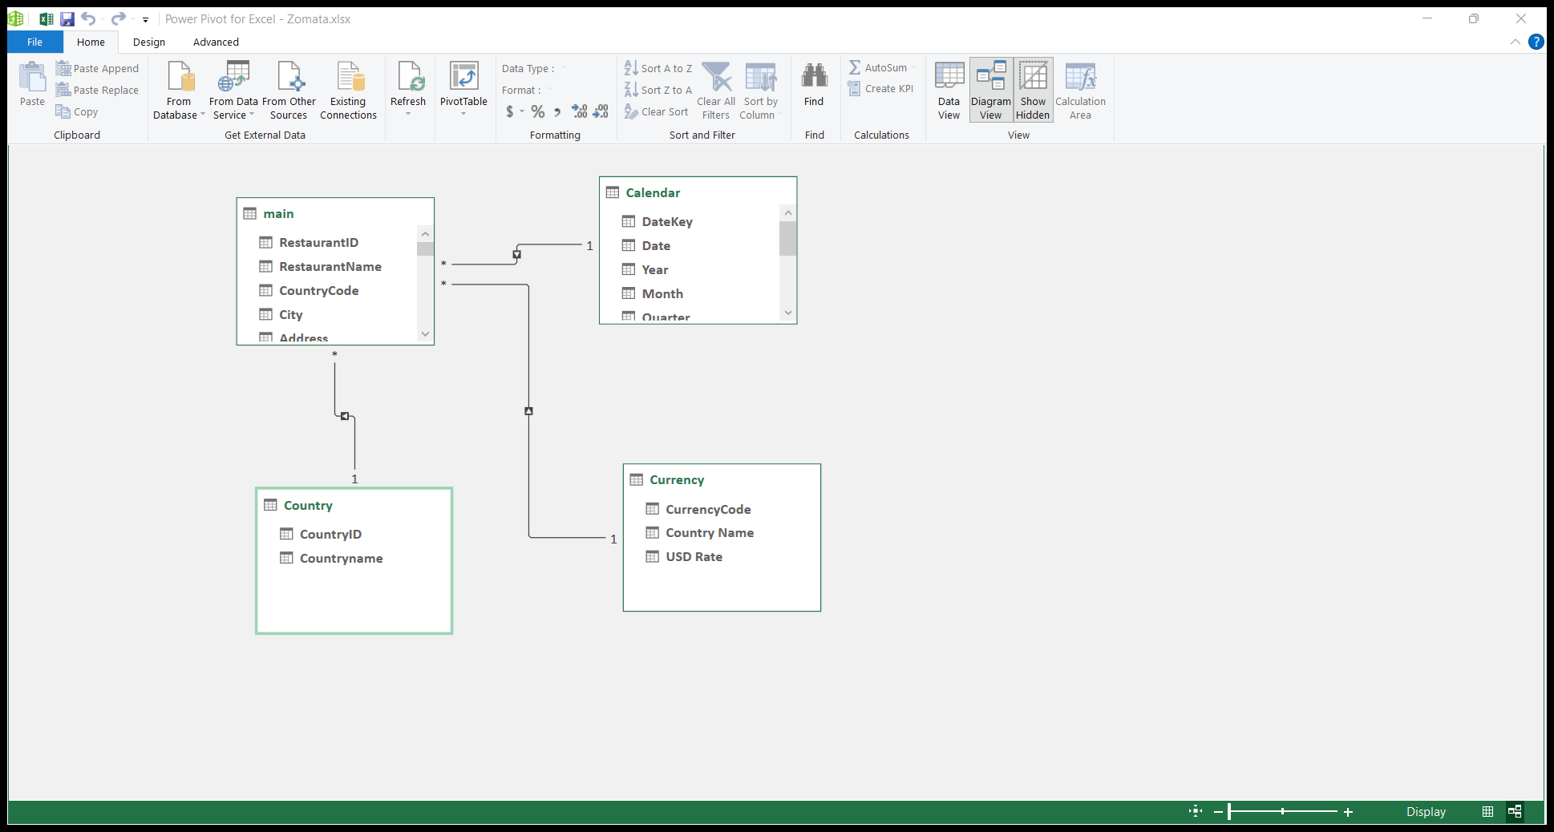
Relationship
We add our all tables to data model to create relation between them and visualize the data using pivot table
🍔🍕🍟🌭🍾🍷🍸🍹🍺🍻🥂

Slide 6
KPI’s and Dashboard
Once the relation is build we are ready to create some kip's and using that kpi we build a Dashboard.
Country wise and city wise count of restaurants
Opening of restaurants based on year, quarter and month
Restaurant has table booking or not
Restaurant has online delivery or not
Map of country wise distribution of restaurants
Top 3 countries with highest number of restaurants
Count of countries, city, Restaurants
Dashboard
🍔🍕🍟🌭🍾🍷🍸🍹🍺🍻🥂

Slide 7
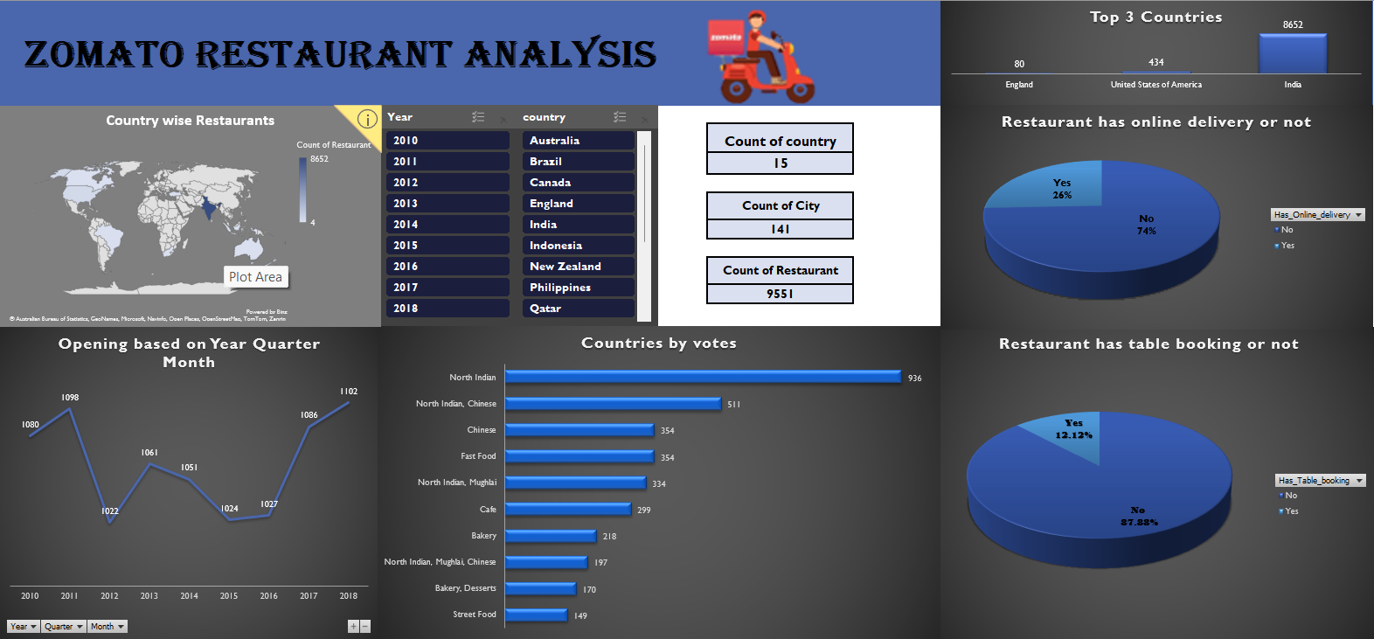
Dashboard
🍔🍕🍟🌭🍾🍷🍸🍹🍺🍻🥂

Slide 8
Challenge Faced
Converting date type.
Making calendar table (finding financial quarter, month)
Finding the country names.
🍔🍕🍟🌭🍾🍷🍸🍹🍺🍻🥂

Slide 9
Power Bi
We upload our main dataset into power bi. Then create a remaining table by using Dax and manually.
We use calendar auto function to create calendar table and use Dax to create remaining column in calendar table.
We manually create Currency table and country table.
After creating all the required table we create a relationship between all the tables.
Also we have used RELATED Function of DAX to calculate Average Cost for two persons column as USD Rates column is in Currency table and we want to have a single currency for Visualizing.
🍔🍕🍟🌭🍾🍷🍸🍹🍺🍻🥂

Slide 10
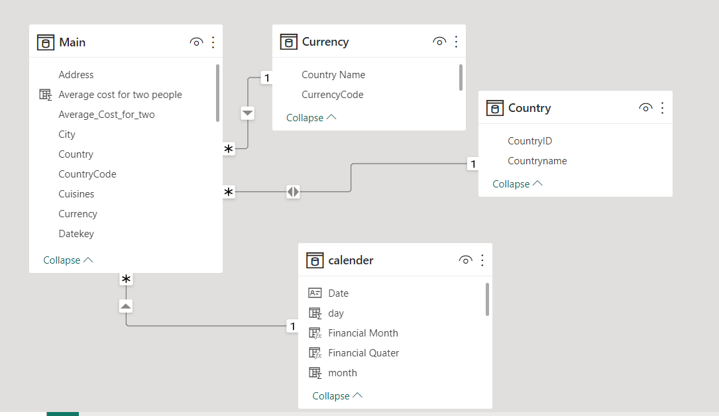
Relationship
After creating all the tables we created a relation between all the tables in model tab
🍔🍕🍟🌭🍾🍷🍸🍹🍺🍻🥂

Slide 11
KPI’s and Dashboard
Country wise and city wise count of restaurants
Opening of restaurants based on year, quarter and month
Restaurant has table booking or not
Restaurant has online delivery or not
Top city by ratings
Average of price range by countries
Count of countries, city, Restaurants
Dashboard
🍔🍕🍟🌭🍾🍷🍸🍹🍺🍻🥂

Slide 12
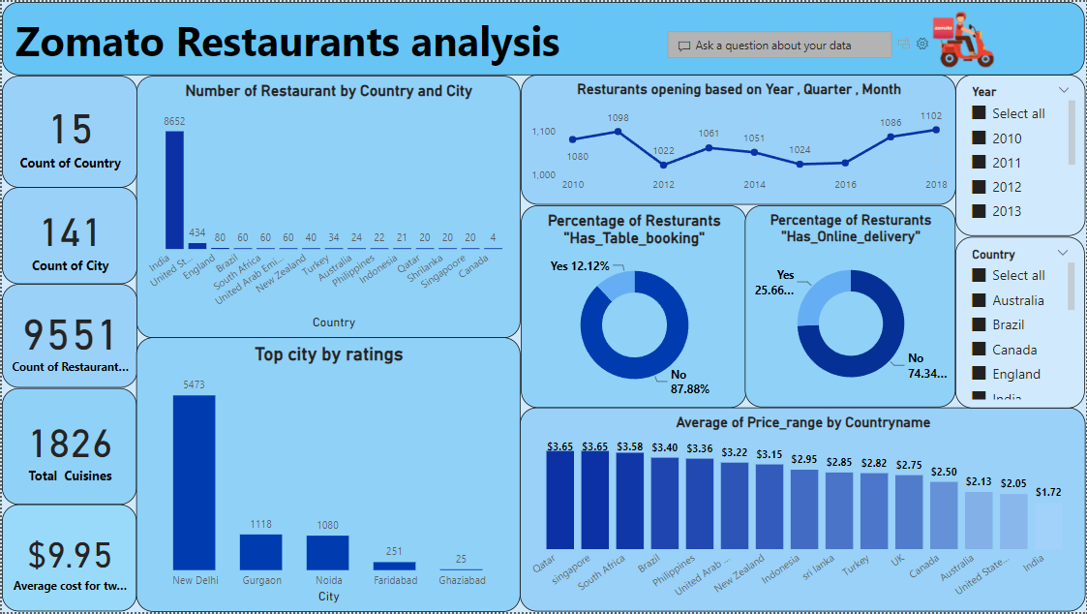
Dashboard
🍔🍕🍟🌭🍾🍷🍸🍹🍺🍻🥂

Slide 13
Challenge Faced
Converting date type.
Making calendar table (finding financial quarter, month)
Finding the country names.
Adjusting relation
🍔🍕🍟🌭🍾🍷🍸🍹🍺🍻🥂

Slide 14
Tableau
We upload our main excel data sheet into the tableau which contain all the require table
We face some problem to uploading the data but we solve it
After adding all the tables into tableau we create a relationship between all the tables
🍔🍕🍟🌭🍾🍷🍸🍹🍺🍻🥂

Slide 15
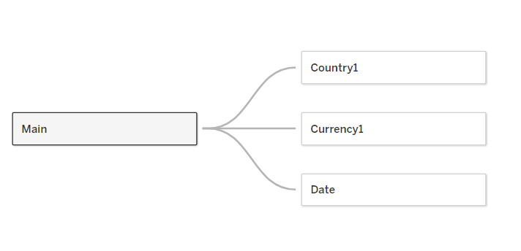
Relationship
We connect all the table to our main data table.
🍔🍕🍟🌭🍾🍷🍸🍹🍺🍻🥂

Slide 16
KPI’s and Dashboard
Country wise and city wise count of restaurants
Opening of restaurants based on year, quarter and month
Restaurant has table booking or not
Restaurant has online delivery or not
Top city by ratings
Map of country wise distribution of restaurants
Prize per in $
Count of countries, city, Restaurants, average prize, cuisines.
Dashboard
🍔🍕🍟🌭🍾🍷🍸🍹🍺🍻🥂

Slide 17
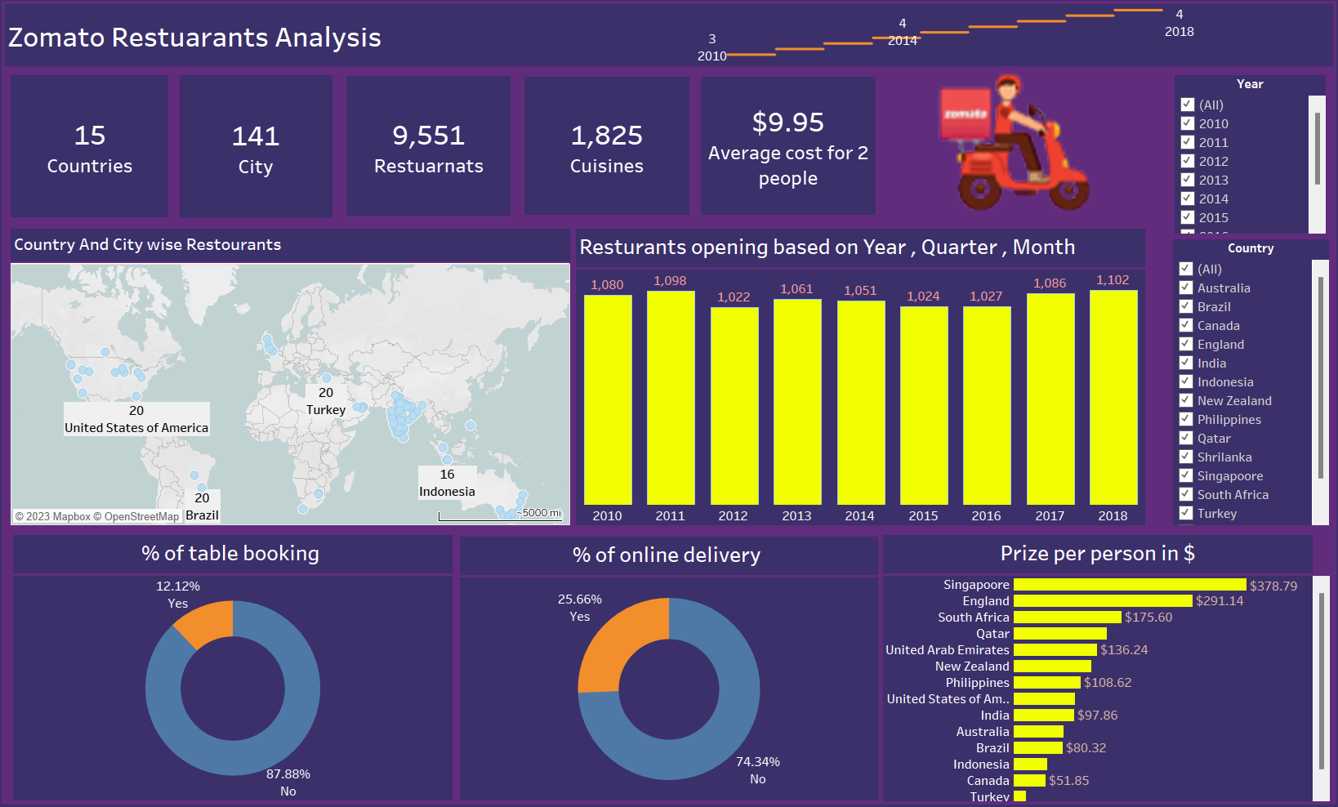
Dashboard

Slide 18
Challenge Faced
Converting date type
Adjusting relation
Plotting some graphs
🍔🍕🍟🌭🍾🍷🍸🍹🍺🍻🥂

Slide 19
SQL
We face some problems in the SQL part
First it is difficult to upload the data into SQL
But finally after so many try we are able to upload all the tables to the SQL
Then we created quries according to our requirements
🍔🍕🍟🌭🍾🍷🍸🍹🍺🍻🥂

Slide 20
KPI’s
Country wise and city wise count of restaurants
Opening of restaurants based on year, quarter and month
Restaurant has table booking or not
Restaurant has online delivery or not
Top city by ratings
Prize per in $
Count of countries, city, Restaurants, average prize, cuisines.
🍔🍕🍟🌭🍾🍷🍸🍹🍺🍻🥂

Slide 21
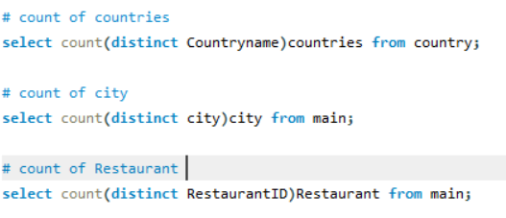
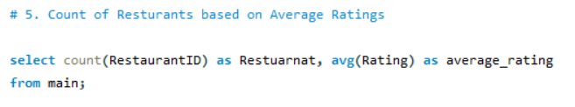
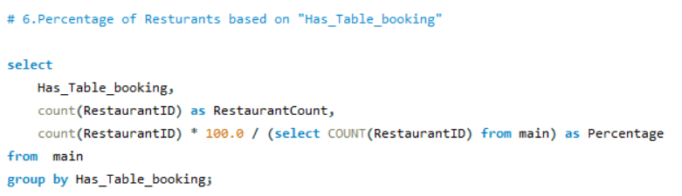
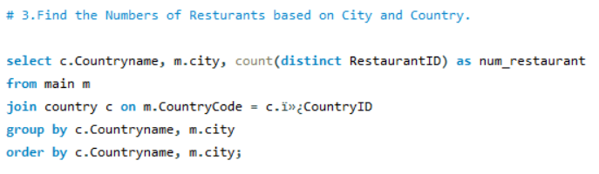
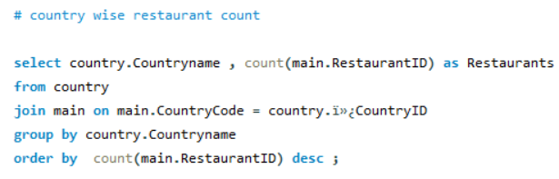
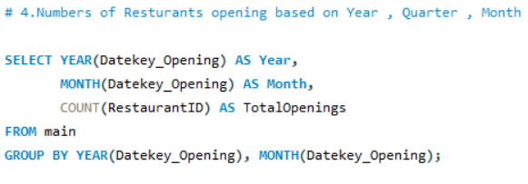
Queries
🍔🍕🍟🌭🍾🍷🍸🍹🍺🍻🥂

Slide 22
Challenge Faced
Uploading data to SQL
Manually create a main table and upload the data in the table
Joining issue in some queries
Converting column to date type
🍔🍕🍟🌭🍾🍷🍸🍹🍺🍻🥂

Slide 23
Thank you 🙏
🍔🍕🍟🌭🍾🍷🍸🍹🍺🍻🥂

